Slide 1
Joel Michael Pope
Moreland University
Module 8, Leadership Project
Progress Update, December 22nd

Slide 2
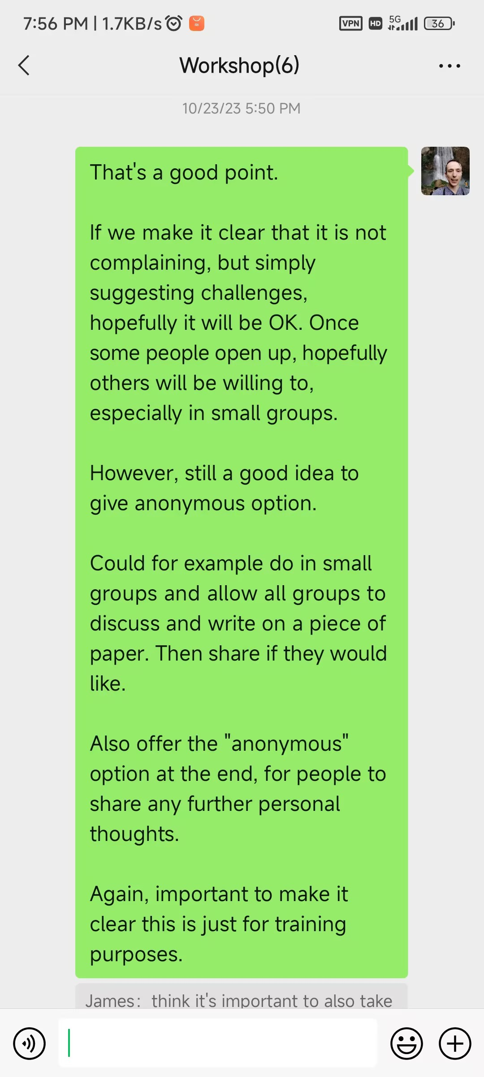
Initial Leadership Project Plan
- Working with a group of teachers, I was involved in the joint planning of training program for our school. I was to be the leader for some of the workshops.
- See here the original plan.

Slide 3
The Developments
- Unfortunately, due to continuous events at school, starting with government evaluations and then a Christmas performance, that required everyone at school to work, hard, the trainings were postponed.
- See here the slide that I had originally prepared for teachers for our first workshop.

Slide 4
The Developments
- I did however do a lead one training workshop for the teachers at my school in August as part of the school’s onboarding process.
Training Title: Sharing my Experience in Reggio-Emilia
See here.
Global Theme: Focusing on an international education philosophy.
Inclusion of School’s Mission/Vision/Goals: Supporting school in developing implementation of it’s IB and Reggio philosophy.
Involvement of School in Implementation: I discussed the workshop’s content with a school leader.
Involvement of Others: Supports teachers in their practice and hence indirectly, students and parents.

Slide 5
The Developments
- Following the school’s government evaluations and Christmas Performance, a change to the training structure was discussed.
- The school is looking to follow a combination of IB and Reggio Emilia philosophies. We will get outside training for IB.
- I have been asked to lead the Reggio training for the rest of this academic year, starting with three workshops in January, before the Chinese New Year vacation.

Slide 6
Reggio Training
The Goal
Because we are also balancing with English language development, IB and government requirements, we cannot implement Reggio in it’s full.
The initial target will be to guide teachers in incorporating student emergent themes and projects within free choice center and unit of enquiry time – discussions could occasionally be incorporated in circle time also.
Later, we can explore broader aspects, including documentation and involvement of parents and community.

Slide 7
Reggio Training
See here my Professional Development Plan, which contains an overview of my targets.
The Plan – January 2023
Workshop 1: “The Hundred Languages of Children”
Discuss different ways in which students can express themselves. Teachers work in their class teams first to reflect on forms of expression favored by students in their class, and then to plan a creative activity for the following week, in which students can have choice in the form of artistic of other expression in which they complete it.
This practically introduces the important idea within the Reggio philosophy.
Workshop 2: “The Image of the Child”
Teachers reflect on times when they have learnt from children, engaging discussions they have had with students, and times when they have been marveled by students' creativity and ideas.
This is important in developing mindset of teacher as a co-learner with students and in being ready to follow and guide students thinking and ideas.
Workshop 3: “Following Student’s Interests and Ideas”
Brief introduction by discussing as a group, examples of how we could use known student interests to brainstorm different activities and directions a project could go.
Teachers then work in their class teaching teams to discuss the student interests in their class and begin to do the same, preparing for possible provocations and activities they could use to guide students, starting most likely in the new semester.

Slide 8
Reggio Training
Current Ideas for Semester 2 – 2024
- Allow teaching teams time to discuss how the student emergent projects are developing and new directions, as well as new emergent interests. Provide support as necessary.
- Allow teaching teams the opportunity to share their projects with the rest of the teaching faculty, allowing us to learn from and support each other.
- Begin to introduce workshops on further areas of the Reggio philosophy that can be applied to our school, including how to follow and guide student conversations and ideas that come up naturally, rather than only well-established interests, the effective use of documentation, environment as the third teacher in more depth, and involvement of parents and the community.
These can be introduced gradually as we become ready. I start with student interests and the use of this, as I feel it is the most quickly and easily applicable.

Slide 9
Reggio Training as a Project
My Role: I will lead the trainings, with the school’s academic head as my assistant. Her and I will discuss the plan and progress together, and we will also check in with the school principal and our investors.
Global Theme: Focusing on an international education philosophy.
Use of Ongoing Reflection and Analysis to Focus on Student Learning and Development:
- I will strive to check in with the teaching teams from each class during workshops, and outside as necessary, regarding the implementation of the student emergent ideas and how they feel it is supporting their students.
- Use this information and other details from observation and discussion with teachers to adapt the training and support as we move forward throughout the school year and beyond.
Inclusion of School’s Mission/Vision/Goals: Supporting school in developing implementation of its Reggio philosophy.
Involvement of School in Implementation: Keep in regular touch with school leadership. Marketing will occasionally be present to take videos and photos of trainings.
Working with Others: School administration will be worked with in planning and scheduling, as necessary. The intention is for the trainings to develop into workshops, with other teachers leading and sharing experiences, hence collaboration with teachers. Indirectly, students are worked with through the development of Reggio projects in each class. As per the Reggio philosophy, eventually, we hope to explore ways for involvement of family and community in our work.

Slide 10
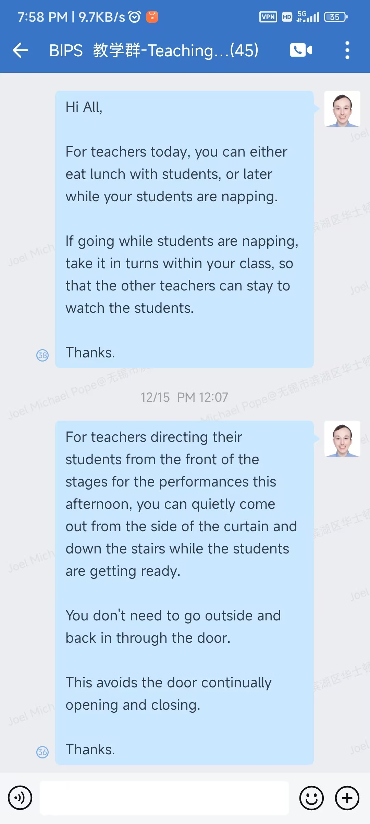
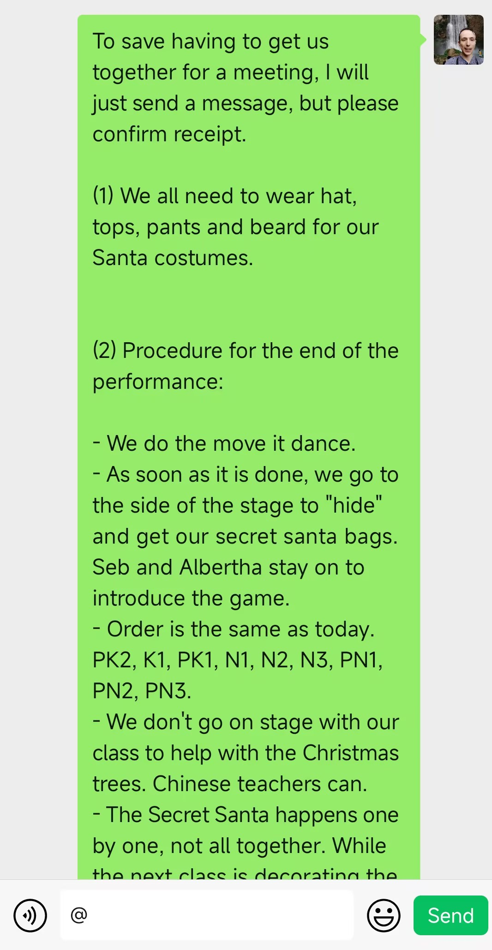
Further Leadership Project at School
From December 1st – December 5th , I had a leadership role in the school’s Christmas performance preparation. Individual class teachers worked with their classes to develop a performance. School management planned the schedule for the day and the after-performance finale.
My Role
- Supporting the hosts in the writing of the script for the performance. Giving them feedback and ideas towards the final script.
- Supporting all classes in their preparation, providing assistance and encouragement as necessary.
- Leading the international teachers through communication beforehand and checking in with them on the day, to ensure they were ready to implement the logistics. (The international teachers in turn, led their classes.)

Slide 11
School Christmas Performance
My Personal Role – As a Project
Global Theme: Cultural awareness – celebrating Christmas and introducing students and families to an overseas festival.
Connection to Observation on Student Learning and Development: As a school, we knew students had had little opportunity to perform on stage before. The goal was hence to provide opportunity for students to develop confidence and the opportunity to express themselves in a way that was meaningful to them and in a new setting.
Supporting a Team of Teachers: I supported the host team in their practice and script writing. I communicated with the international teacher team about details.
Alignment with School’s Goals and Objectives and Involvement of School: The performance was in line with the school’s goal to provide new opportunities for students, to provide opportunity for involvement and shared experience with parents, as well as to develop recognition of the school’s work.
I communicated with the school principal and academic head, who were in charge of the performance, as well as with the hosting team
Collaborating with Others: This was an event in which every member of staff had a role. Hence, there was cooperation with teachers and staff from other departments as we prepared. I collaborated with parents within my class as I organized a Secret Santa with them for the students for the end of the performance. There was some collaboration from the wider community as the performance was at the Theatre for another school and so we needed to communicate with the Theatre staff there in preparation and on the day.

Slide 12
School Christmas Performance
Focus on My Class's Performance
Collaboration: I worked with students in the development of our performance, as students chose the songs, there own costumes, and their method of expression.
I collaborated with the teaching team within my class.
Observation on Student Learning and Development: Students like to express themselves in different ways. Hence, I gave them the option of either focusing on dancing, singing, or using a percussion instrument as we performed the song.
To provide a further opportunity to practice introducing themselves in their second language, I worked with them to create a video in which we introduced our performance.
Video here.

Slide 13
Reflection on Projects
Impacts of Leadership Project
Start of Year Experience Sharing Workshop
Some impact has been seen on teachers and therefore their students.
- Teachers noted the usefulness of brainstorming ideas for the direction open projects could go, to inform activities, provocations and discussions. One colleague has discussed with me how he has applied it in his class to small projects on camping and “getting around town”, taking the projects further, including making a model road in the corridor with street signs to practice writing, construction, team cooperation and planning.
- Teachers also noted that they have incorporated more open discussions, allowing students to ponder and talk about ideas, rather than simply go straight to the answer, to support deeper thinking. For example, for the Chinese Mid-Autumn Festival, one teacher shared a discussion he had with his students on the moon cycles and reasons for it.
For me, it was a good opportunity to reflect on my own experiences and what might be beneficial for others.

Slide 14
Reflection on Projects
Impacts of Leadership Project
Christmas Performance
- For me, it allowed me to get to know all colleagues around school better, and strengthen our working relationships, which prepares us for stronger communication in the future. In addition, I was able to spend time getting to know the teaching teams and students in classes around school, as I gave encouragement and support for their performance. This will allow support me in the planning for my future training to make it most beneficial to teachers and students.
- For students, it was beautiful to see the growth in confidence and pride from our first rehearsal on stage, to the final performance and importantly, to enjoy themselves as they expressed themselves in this new experience, supporting areas of development.
- For the school community at large, as an event involving everyone, it was able to strengthen our relationships and cooperation. Lots of challenges were faced, providing areas of reflection, which will be able to support the school community at large with better communication and planning in our future work. Similarly, individuals, especially teachers, were able to work on a different type of project with their students, supporting their own development. Marketing and documentation from the event helps grow the school’s image.

Slide 15
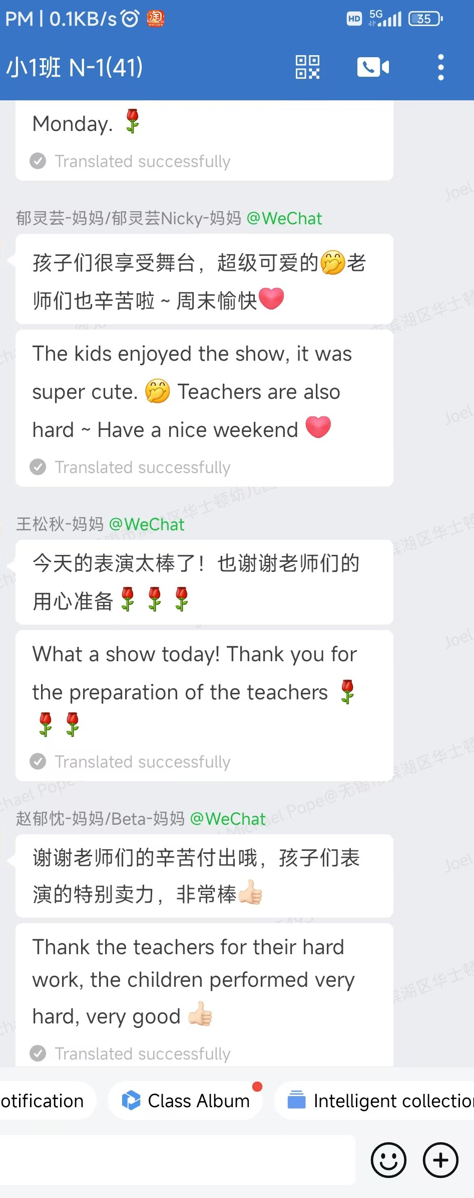
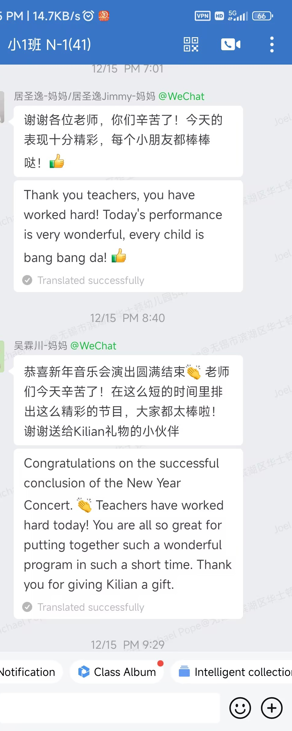
Reflection on Projects
Impacts of Leadership Project

Slide 16
Reflection on Projects
My Lessons Learned and the Impact on My Future Actions and Potential Leadership Roles
- Although my workshop at the start of the school year had some impact, I also received feedback that although the sharing of my experiences provided some inspiration and ideas, it didn’t directly support teachers in applying ideas from Reggio in their own classroom, given our school’s teaching context.
This was a valuable reminder of the importance of working to make training and support as practical and applicable as possible, considering the set up of the school and the backgrounds and situations of the teaching teams. I am striving to apply this to the Reggio training I am now in the process of planning, focusing on ways in which I think the philosophy could be applied in our school, individual class support and workshops where teachers are directly able to plan how to use ideas in their class teaching teams.
- In both our original training plan, which had to be changed, and in the Christmas performance preparation, which saw many changes, I have grown to see of the importance of flexibility and embracing challenge, especially in a new school and if new ideas are being tried. For future leadership positions, while it will be important to have a vision and a plan, I will also approach with flexibility and an open mind. As above, I will remember to always keep at the front of my mind, what is most practically applicable at the school.
- Finally, I have seen the benefits of staying positive through difficult times, and the impact this can have on the morale of those around you. I will try to bring this mindset in to my future work.

Slide 17
In addition…
Reflection on Meeting Standard 10.I
- Throughout Modules 1 – 7 of the program, I worked closely with cohort members on collaborative assignments, and in the giving and receiving of feedback, as shown through the feedback and score. I engaged in discussions in VC’s and the Discussion Forum.
- I have regrettably been behind on my work in Module 8. As a result, I did miss out on the opportunity to have my teaching videos reviewed by peers. In addition, I was very late with all, but the first peer reviews completed by myself. This does mean that peers weren’t able to benefit from the feedback during the clinical practice. I have however, endeavored to be rigorous with my feedback and sent it to my peers for reference for their future teacher.
- Elsewhere in Module 8, I have done my best to be proactive. I have got involved in forum discussions and feedback, as well as in discussions and the giving and receiving of feedback during the student case studies in the VC’s, for which I also helped support the process taking on Facilitator, Notetaker and Timekeeper roles.

Slide 18
Thank you!

